Slide 1
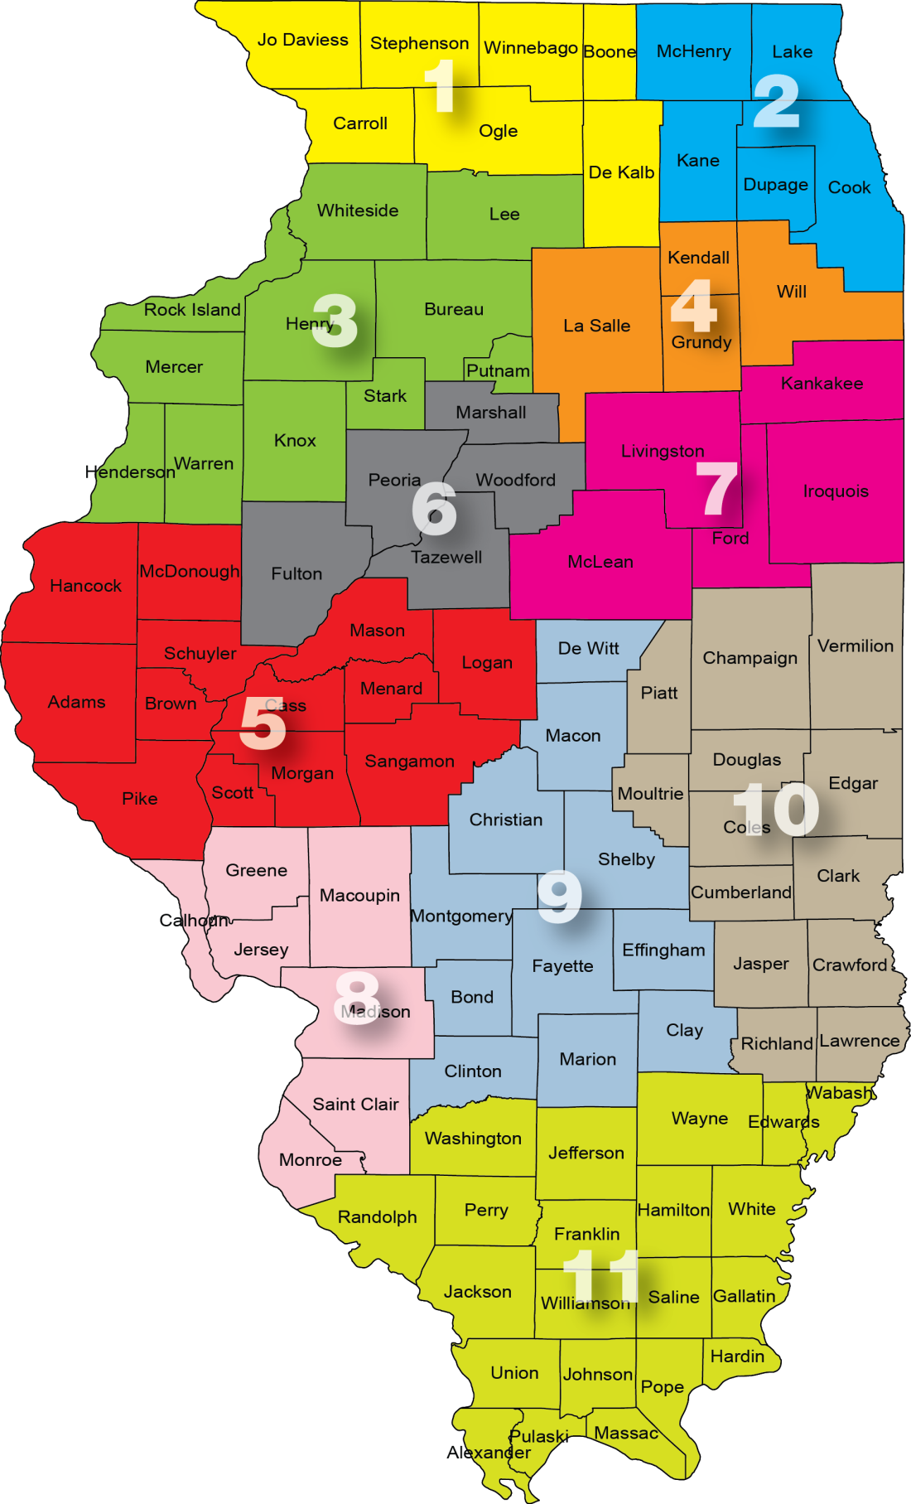
ILLINOIS AUTOMOBILE DEALERS ASSOCIATION BOARD OF DIRECTORS 2024
IADA Officers
John Alfirevich, Chairman Jamie Auffenberg, Vice Chairman
Rick Curia, Secretary/Treasurer
25 IADA Directors by Districts
District 1
Pat Manning, Dekalb PC
Dave Kieffer, Rockford (24)
District 2 – Chicago Area
John Alfirevich, Tinley Park (25)* Mike Ettleson, Hodgkins PC Jim Leichter, Elgin (25)
Joe Massarelli, Libertyville (26)* Dan Roesch, Elmhurst PC
District 3
Rick Curia, Dixon (26)*
Rick Yemm, Galesburg (PC)
District 4
Darrin Bauer, Wilmington (26)*
Curtis Pascarella, Frankfort (24)
District 5
Mylas Copeland, Springfield (25)
District 6
Brian Dennison, Pekin (25)*
Mike Mangold, Eureka PC (At large Peoria Metro)
District 7
Ryan Gremore, Normal (25)*
(NADA) at large
Dave Taylor, Bourbonnais PC
District 8
Jamie Auffenberg, Jr. Shiloh (24)* Bob Federico, Wood River (24)*
Sam Roberts, Alton PC
Jack Schmitt, O’Fallon PC (at large St. Clair/Madison)
District 9
Sean Grant, Taylorville, PC
District 10
Gary Knight, Danville PC
David Parkhill, Champaign PC*
District 11
Mark Ward, Carbondale (24) Heavy Duty Truck Dealer Justin Hopkins, Troy (24)
IADA has 25 Directors serving on the IADA Board. There are 11 Past Chairmen (bolded & PC). Number in parenthesis represents expiring term in office. Executive Committee highlighted with an (*).

